Slide 1
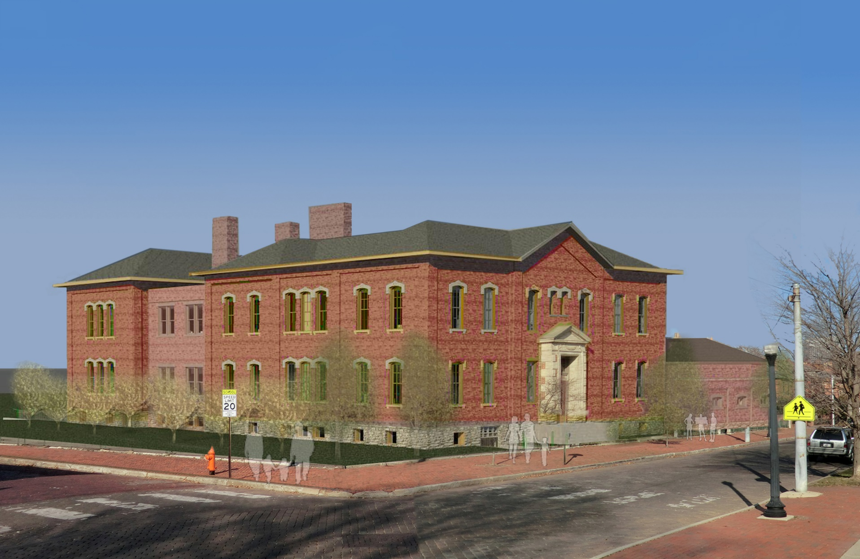
Introduction
Project Background
Analysis 1: 3rd Party Photo Documentation
Analysis 2: Cast-in-Place Concrete Floors
Analysis 3: PEX Domestic Water System
Conclusion
Final Report Presentation
April 16th, 2014
Raymond Scott Pell, Jr.
Construction Management Option
Advisor: Dr. Robert Leicht
Central Ohio Elementary School
Undisclosed Location, Ohio

Slide 2
Introduction
Project Background
Analysis 1: 3rd Party Photo Documentation
Analysis 2: Cast-in-Place Concrete Floors
Analysis 3: PEX Domestic Water System
Conclusion
Project Background

Slide 3
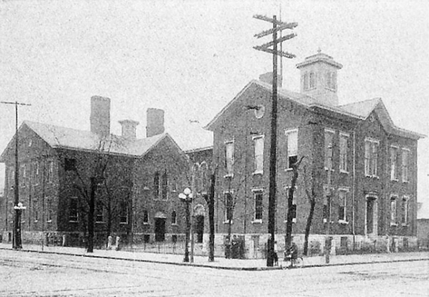
Introduction
Project Background
Analysis 1: 3rd Party Photo Documentation
Analysis 2: Cast-in-Place Concrete Floors
Analysis 3: PEX Domestic Water System
Conclusion
The Building
Built: Original Building – 1874
Multiple Renovations
Occupancy: K-5 Grade School
Location: Urban Neighborhood
Closed: 2010 (due to fire damage)

Slide 4
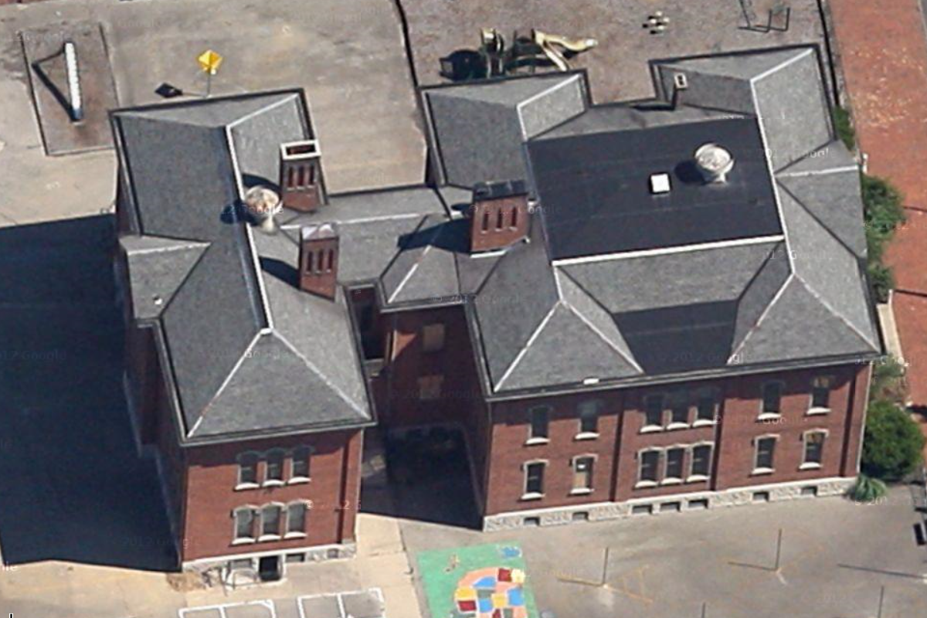



Introduction
Project Background
Analysis 1: 3rd Party Photo Documentation
Analysis 2: Cast-in-Place Concrete Floors
Analysis 3: PEX Domestic Water System
Conclusion
The Project
Size: 28,000 sqft (Renovation) + 18,000 sqft (Addition)
Number of Stories: 3 Stories + Unoccupied Attic
Construction Cost: $9.07 Million
Total Project Cost: $11.2 Million
Construction Start: August 13, 2014
Construction End: January 23, 2015
Project Delivery Method: Single Prime w/ CM Advisor
The Team
Designer: Hardlines Design Company
Project Manager: Smoot Elford Resources
General Contractor: Miles McClellan Construction Co.

Slide 5
Introduction
Project Background
Analysis 1: 3rd Party Photo Documentation
Analysis 2: Cast-in-Place Concrete Floors
Analysis 3: PEX Domestic Water System
Conclusion
Analysis #1:
Third-Party Photo Documentation

Slide 6
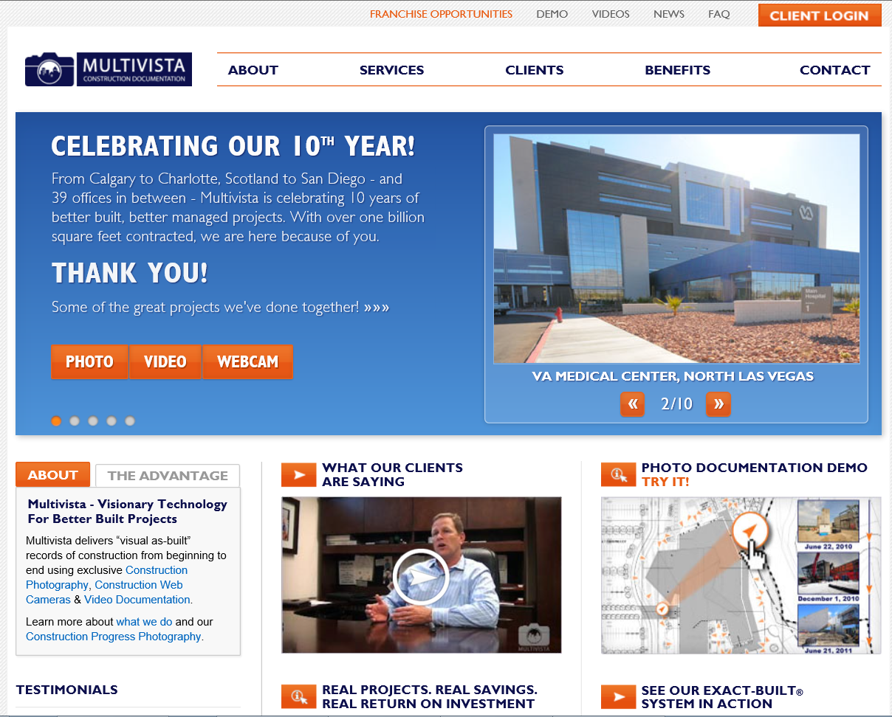

Introduction
Project Background
Analysis 1: 3rd Party Photo Documentation
Analysis 2: Cast-in-Place Concrete Floors
Analysis 3: PEX Domestic Water System
Conclusion
Background:
Multivista Systems, LLC providing service
Milestone photography
Progression photography
Web-based software

Slide 7
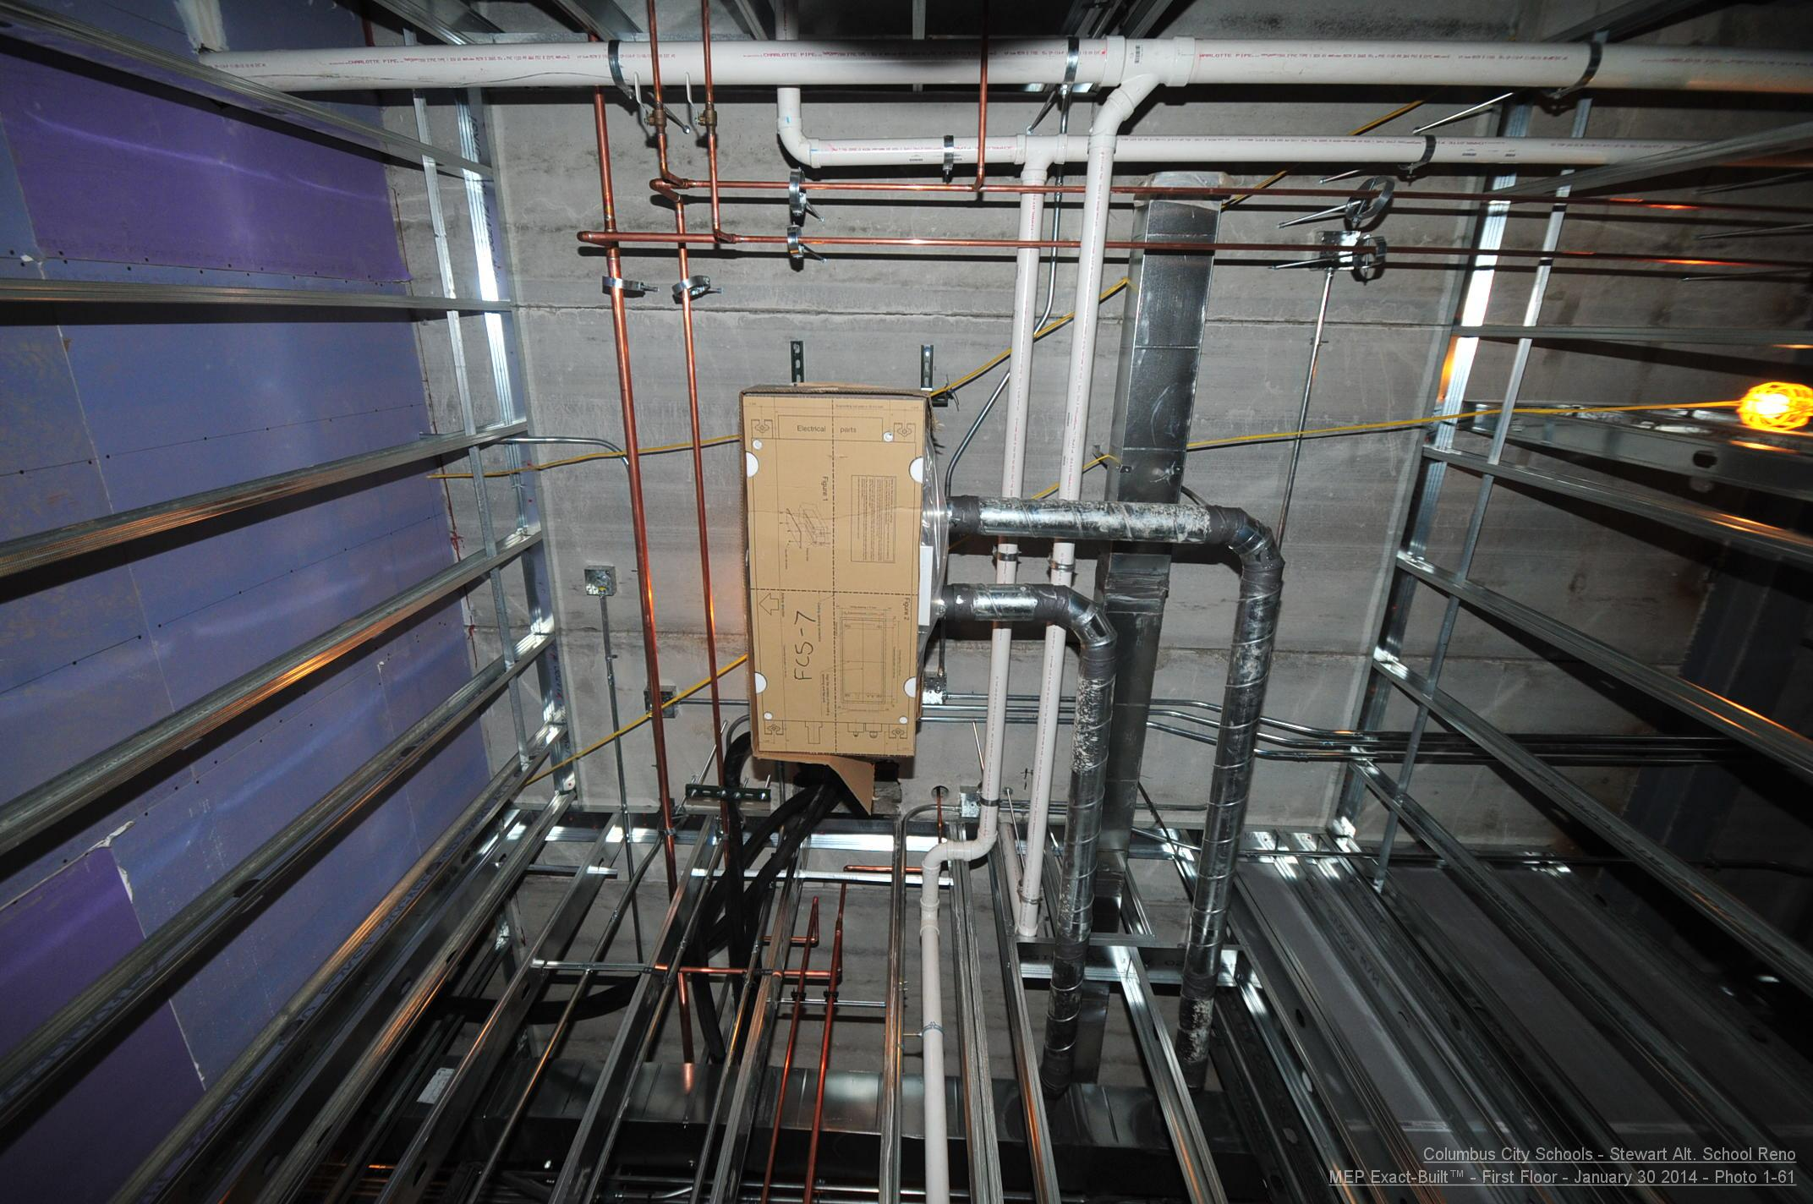
Introduction
Project Background
Analysis 1: 3rd Party Photo Documentation
Analysis 2: Cast-in-Place Concrete Floors
Analysis 3: PEX Domestic Water System
Conclusion
Background:
Multivista Systems, LLC providing service
Milestone photography
Progression photography
Web-based software

Slide 8
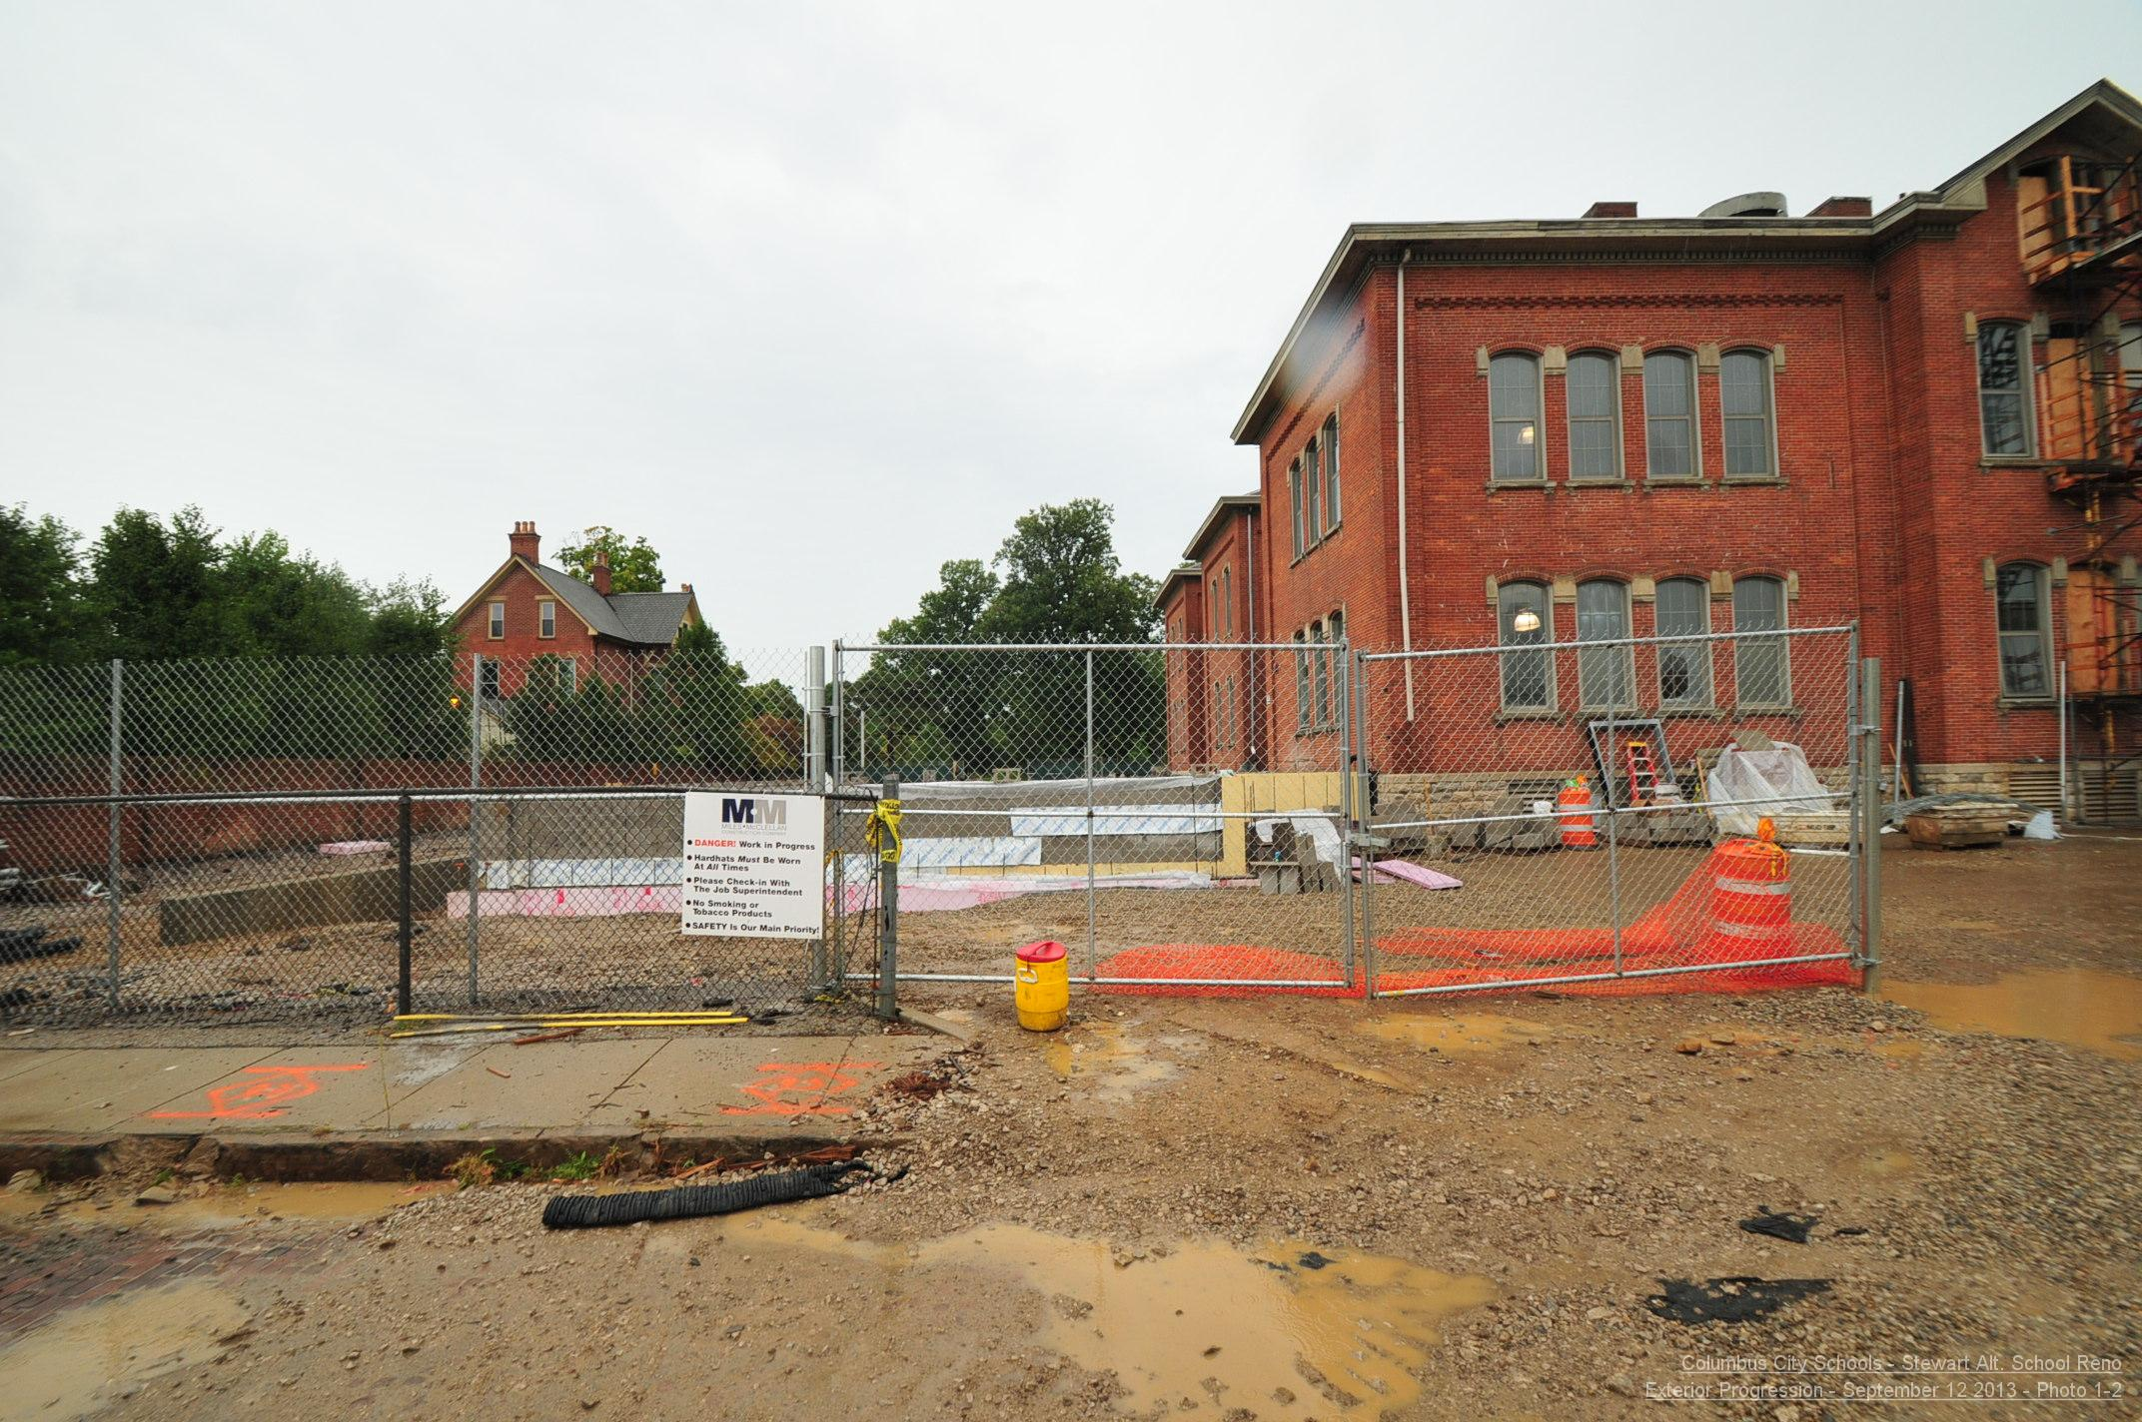
Introduction
Project Background
Analysis 1: 3rd Party Photo Documentation
Analysis 2: Cast-in-Place Concrete Floors
Analysis 3: PEX Domestic Water System
Conclusion
Background:
Multivista Systems, LLC providing service
Milestone photography
Progression photography
Web-based software
September 12, 2013

Slide 9
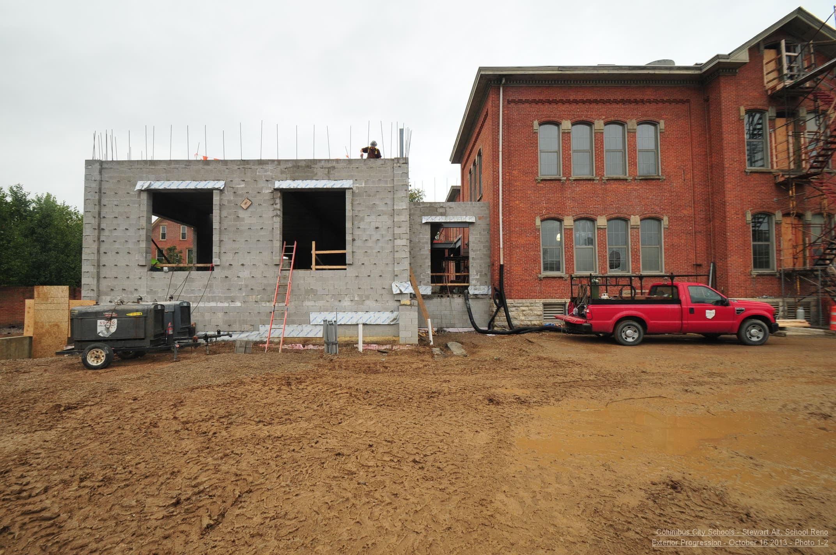
Introduction
Project Background
Analysis 1: 3rd Party Photo Documentation
Analysis 2: Cast-in-Place Concrete Floors
Analysis 3: PEX Domestic Water System
Conclusion
Background:
Multivista Systems, LLC providing service
Milestone photography
Progression photography
Web-based software
October 16, 2013

Slide 10
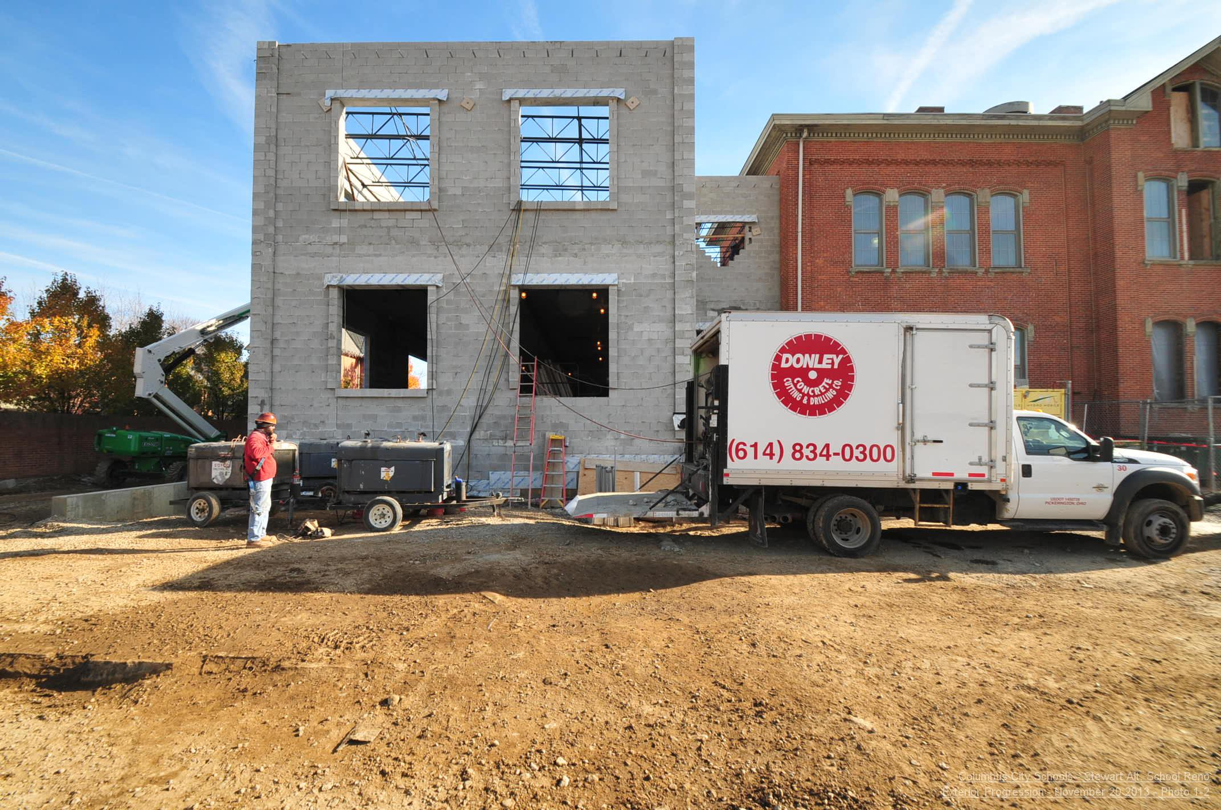
Introduction
Project Background
Analysis 1: 3rd Party Photo Documentation
Analysis 2: Cast-in-Place Concrete Floors
Analysis 3: PEX Domestic Water System
Conclusion
Background:
Multivista Systems, LLC providing service
Milestone photography
Progression photography
Web-based software
November 20, 2013

Slide 11
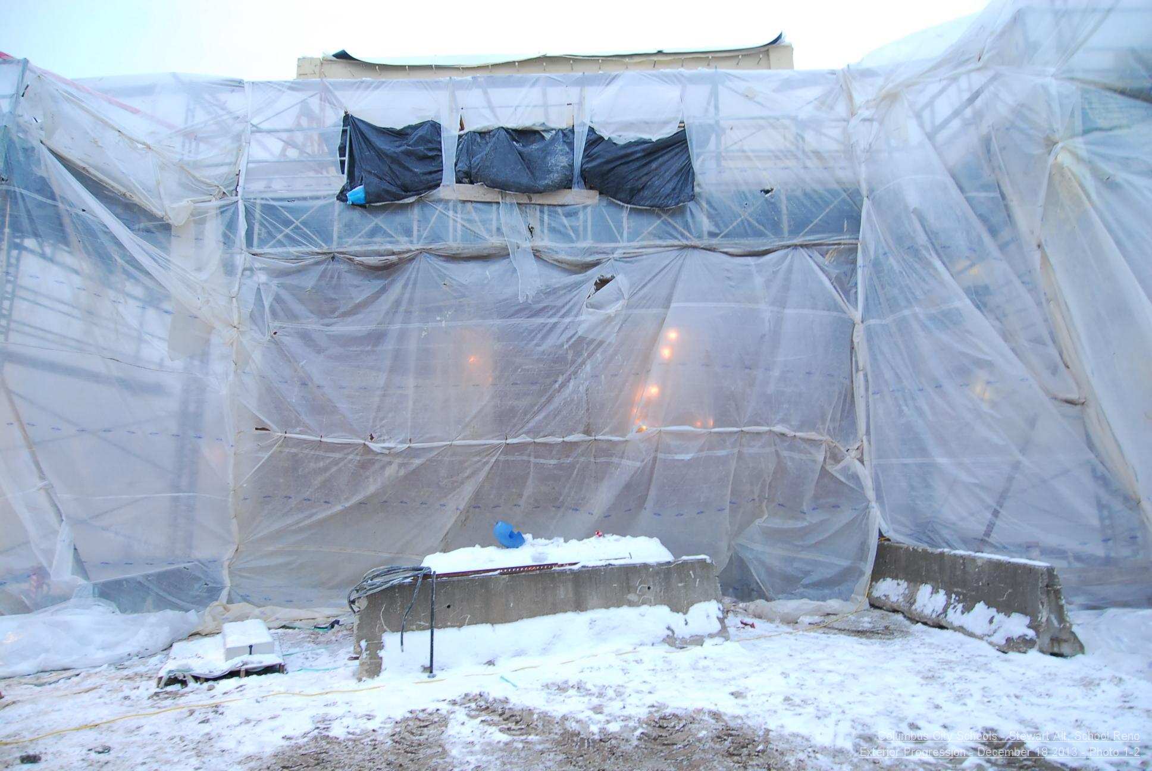
Introduction
Project Background
Analysis 1: 3rd Party Photo Documentation
Analysis 2: Cast-in-Place Concrete Floors
Analysis 3: PEX Domestic Water System
Conclusion
Background:
Multivista Systems, LLC providing service
Milestone photography
Progression photography
Web-based software
December 18, 2013

Slide 12
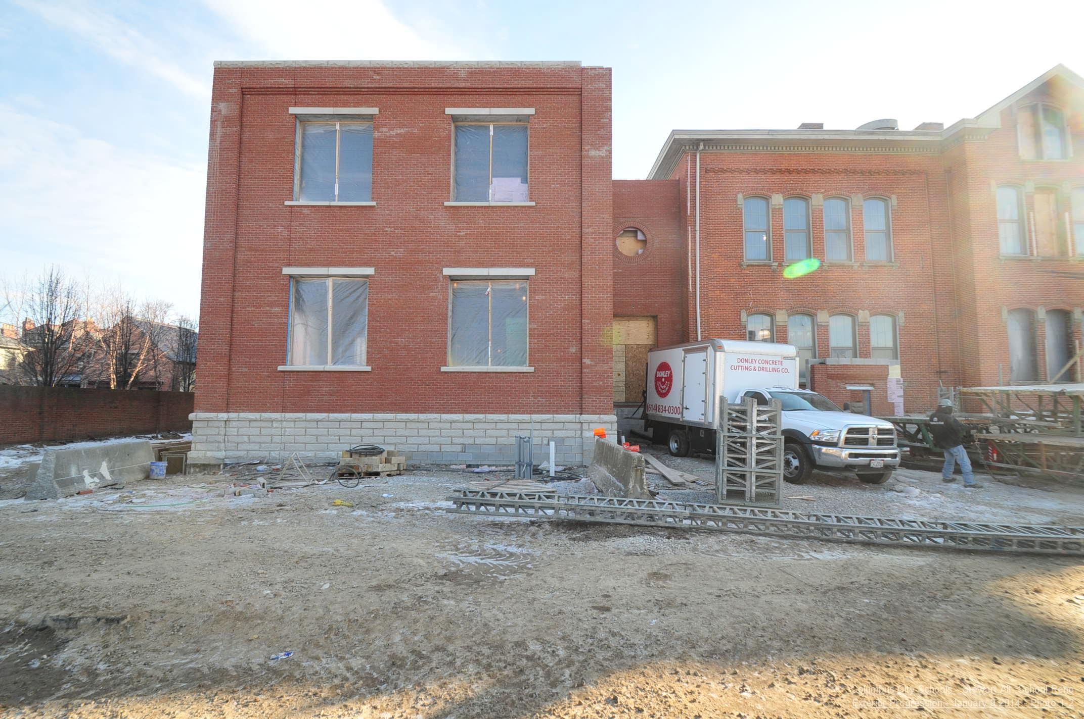
Introduction
Project Background
Analysis 1: 3rd Party Photo Documentation
Analysis 2: Cast-in-Place Concrete Floors
Analysis 3: PEX Domestic Water System
Conclusion
Background:
Multivista Systems, LLC providing service
Milestone photography
Progression photography
Web-based software
January 9, 2014

Slide 13
Introduction
Project Background
Analysis 1: 3rd Party Photo Documentation
Analysis 2: Cast-in-Place Concrete Floors
Analysis 3: PEX Domestic Water System
Conclusion
Background:
Multivista Systems, LLC providing service
Milestone photography
Progression photography
Web-based software
January 9, 2014

Slide 14
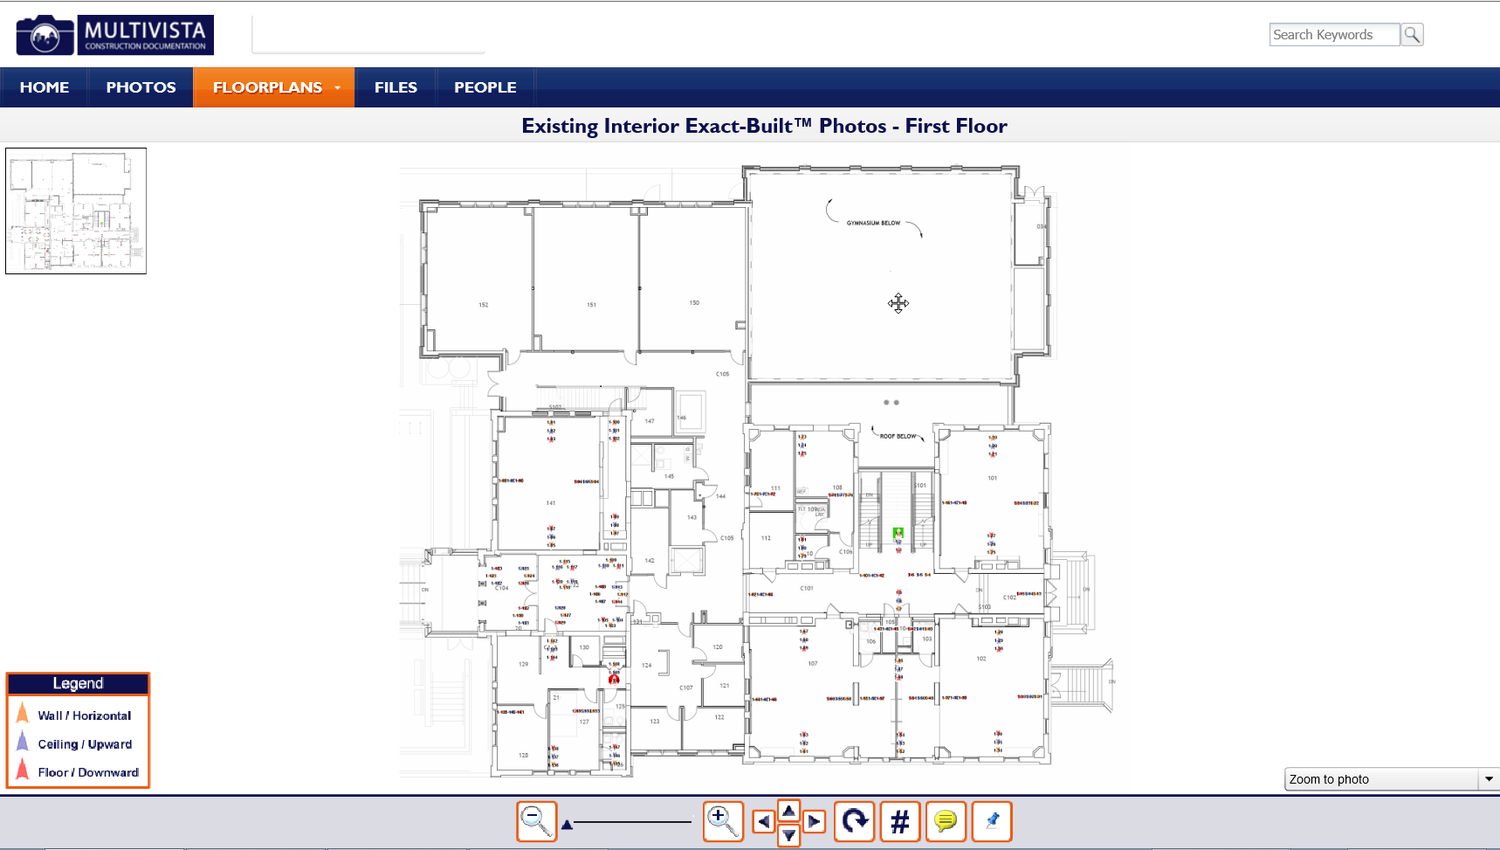
Introduction
Project Background
Analysis 1: 3rd Party Photo Documentation
Analysis 2: Cast-in-Place Concrete Floors
Analysis 3: PEX Domestic Water System
Conclusion
Background:
Multivista Systems, LLC providing service
Milestone photography
Progression photography
Web-based software

Slide 15
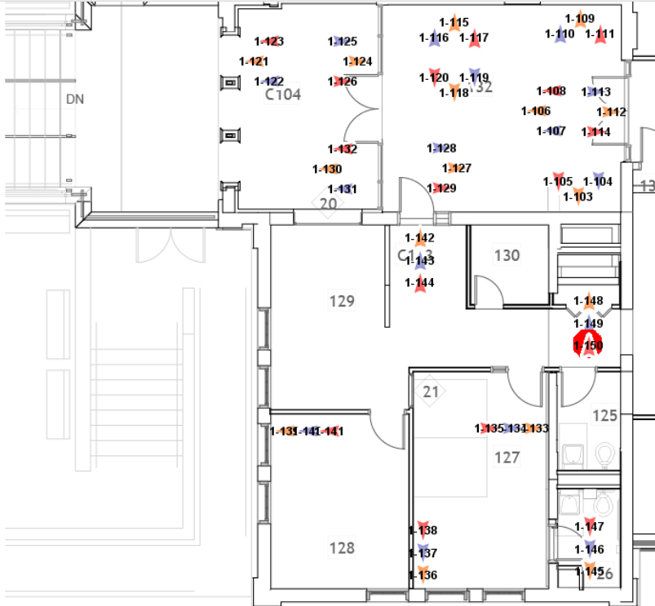
Introduction
Project Background
Analysis 1: 3rd Party Photo Documentation
Analysis 2: Cast-in-Place Concrete Floors
Analysis 3: PEX Domestic Water System
Conclusion
Background:
Multivista Systems, LLC providing service
Milestone photography
Progression photography
Web-based software

Slide 16
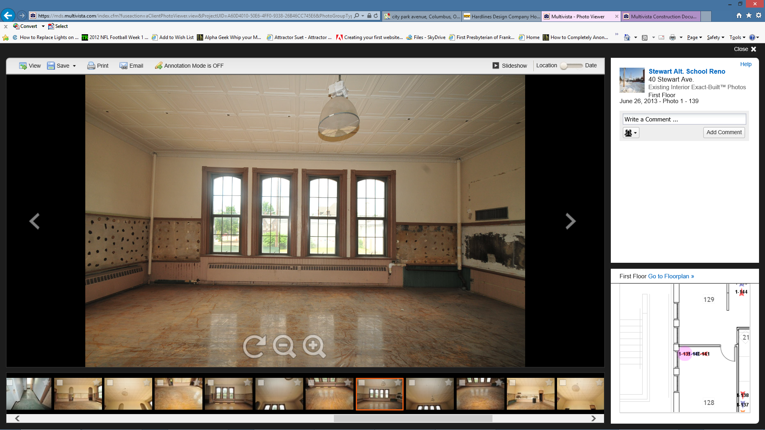
Introduction
Project Background
Analysis 1: 3rd Party Photo Documentation
Analysis 2: Cast-in-Place Concrete Floors
Analysis 3: PEX Domestic Water System
Conclusion
Background:
Multivista Systems, LLC providing service
Milestone photography
Progression photography
Web-based software

Slide 17
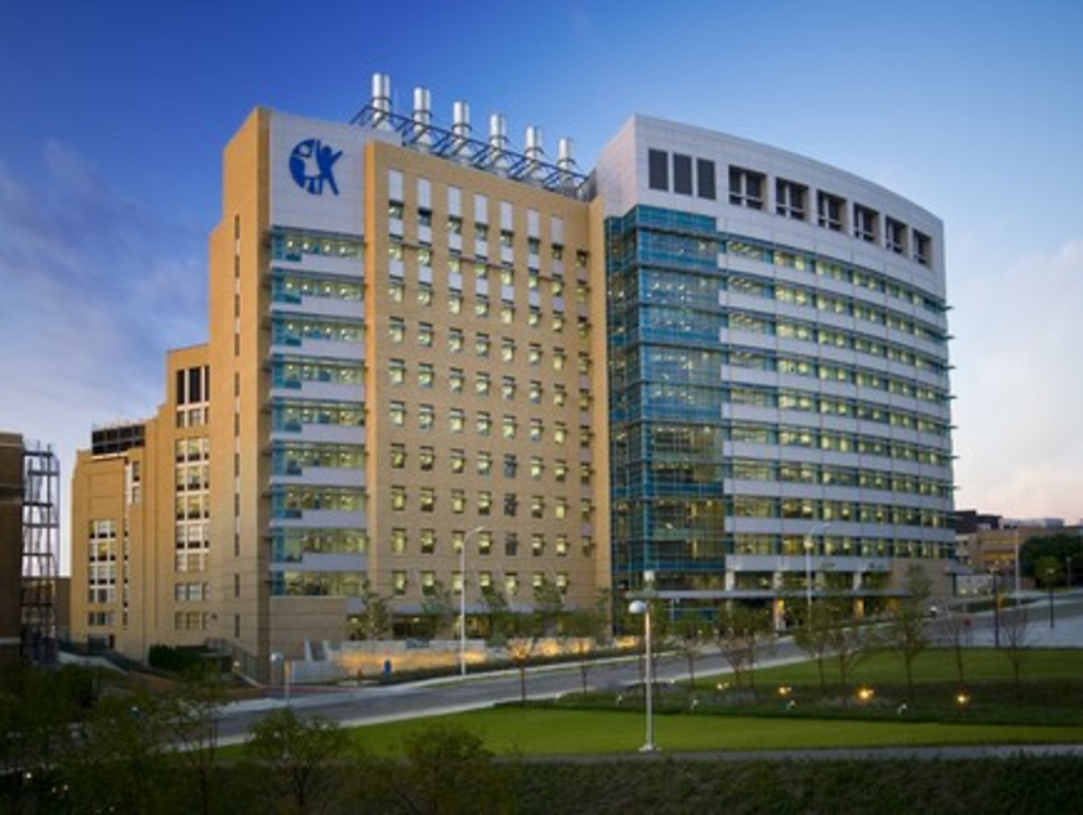
Introduction
Project Background
Analysis 1: 3rd Party Photo Documentation
Analysis 2: Cast-in-Place Concrete Floors
Analysis 3: PEX Domestic Water System
Conclusion
Case Study:
Newly Constructed Ohio-based Children’s Hospital
ADA handrails in patient bathrooms detached from wall
Destructive testing found proper support was absent
400 bathrooms needed tested
Referenced MEP Exact-Built® photos
Only 42 bathrooms needed fixed
Saved almost $210,000 and 3400 hours

Slide 18
Introduction
Project Background
Analysis 1: 3rd Party Photo Documentation
Analysis 2: Cast-in-Place Concrete Floors
Analysis 3: PEX Domestic Water System
Conclusion
Case Study:
Newly Constructed Ohio-based Children’s Hospital
ADA handrails in patient bathrooms detached from wall
Destructive testing found proper support was absent
400 bathrooms needed tested
Referenced MEP Exact-Built® photos
Only 42 bathrooms needed fixed
Saved almost $210,000 and 3400 hours

Slide 19
Introduction
Project Background
Analysis 1: 3rd Party Photo Documentation
Analysis 2: Cast-in-Place Concrete Floors
Analysis 3: PEX Domestic Water System
Conclusion
Case Study:
Newly Constructed Ohio-based Children’s Hospital
ADA handrails in patient bathrooms detached from wall
Destructive testing found proper support was absent
400 bathrooms needed tested
Referenced MEP Exact-Built® photos
Only 42 bathrooms needed fixed
Saved almost $210,000 and 3400 hours

Slide 20
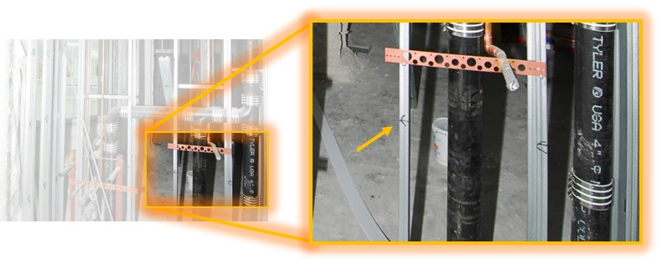
Introduction
Project Background
Analysis 1: 3rd Party Photo Documentation
Analysis 2: Cast-in-Place Concrete Floors
Analysis 3: PEX Domestic Water System
Conclusion
Case Study:
Newly Constructed Ohio-based Children’s Hospital
ADA handrails in patient bathrooms detached from wall
Destructive testing found proper support was absent
400 bathrooms needed tested
Referenced MEP Exact-Built® photos
Only 42 bathrooms needed fixed
Saved almost $210,000 and 3400 hours

Slide 21
Introduction
Project Background
Analysis 1: 3rd Party Photo Documentation
Analysis 2: Cast-in-Place Concrete Floors
Analysis 3: PEX Domestic Water System
Conclusion
Case Study:
Newly Constructed Ohio-based Children’s Hospital
ADA handrails in patient bathrooms detached from wall
Destructive testing found proper support was absent
400 bathrooms needed tested
Referenced MEP Exact-Built® photos
Only 42 bathrooms needed fixed
Saved almost $210,000 and 3400 hours

Slide 22
Introduction
Project Background
Analysis 1: 3rd Party Photo Documentation
Analysis 2: Cast-in-Place Concrete Floors
Analysis 3: PEX Domestic Water System
Conclusion
Case Study:
Newly Constructed Ohio-based Children’s Hospital
ADA handrails in patient bathrooms detached from wall
Destructive testing found proper support was absent
400 bathrooms needed tested
Referenced MEP Exact-Built® photos
Only 42 bathrooms needed fixed
Saved almost $210,000 and 3400 hours
$225,200
-$15,330
$209,900
3600 hrs
-252 hrs
3348 hrs

Slide 23
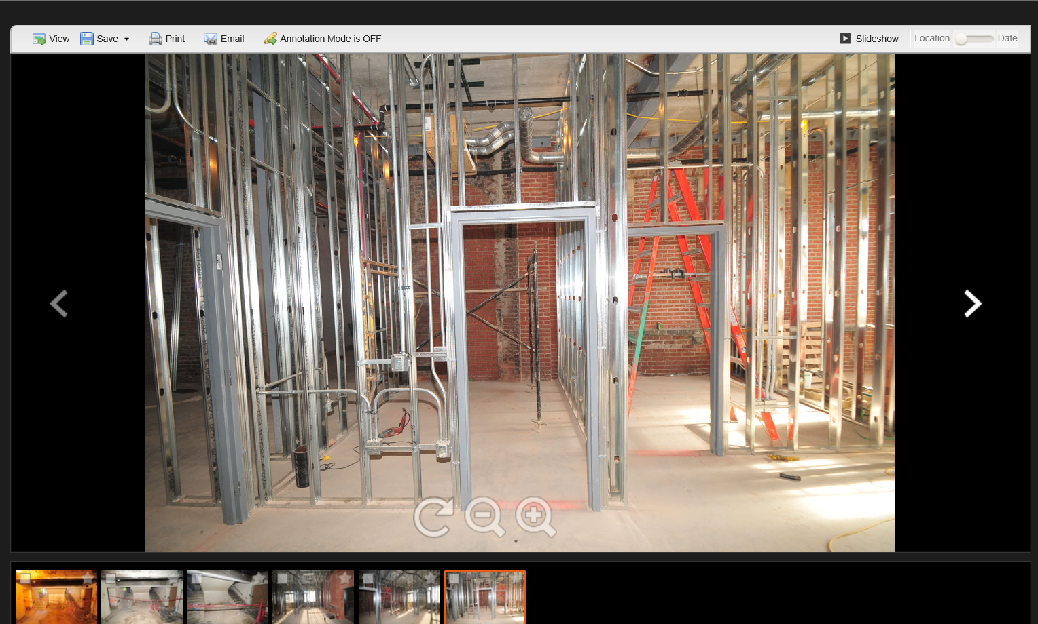
Introduction
Project Background
Analysis 1: 3rd Party Photo Documentation
Analysis 2: Cast-in-Place Concrete Floors
Analysis 3: PEX Domestic Water System
Conclusion
Advantages:
Relieves site superintendent of responsibility
Photos are immediately available and organized
Simple to use
Potential increase in productivity
Reduces litigation
“Green” alternative to printed drawings and photos
Disadvantages:
Additional cost
Doesn’t guarantee photographs of everything
Requires willingness to learn and use

Slide 24
Introduction
Project Background
Analysis 1: 3rd Party Photo Documentation
Analysis 2: Cast-in-Place Concrete Floors
Analysis 3: PEX Domestic Water System
Conclusion
Analysis #2:
Use of Steel Deck and
Cast-in-Place Concrete

Slide 25
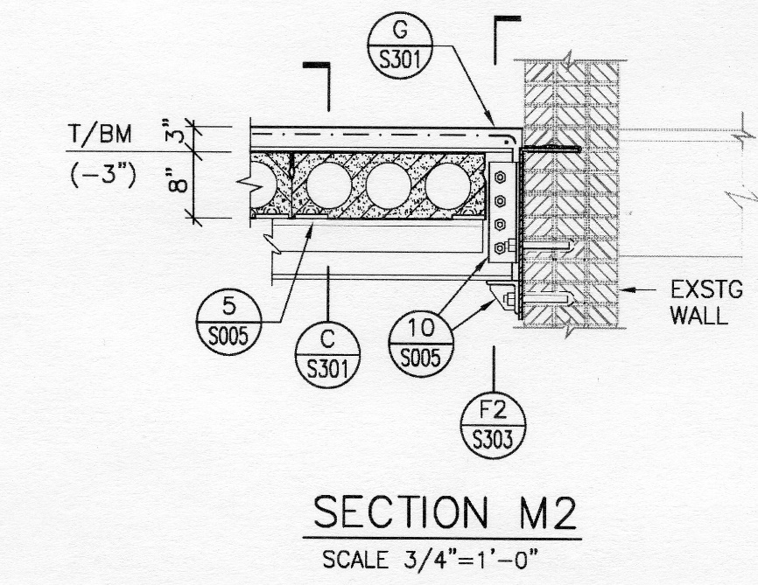
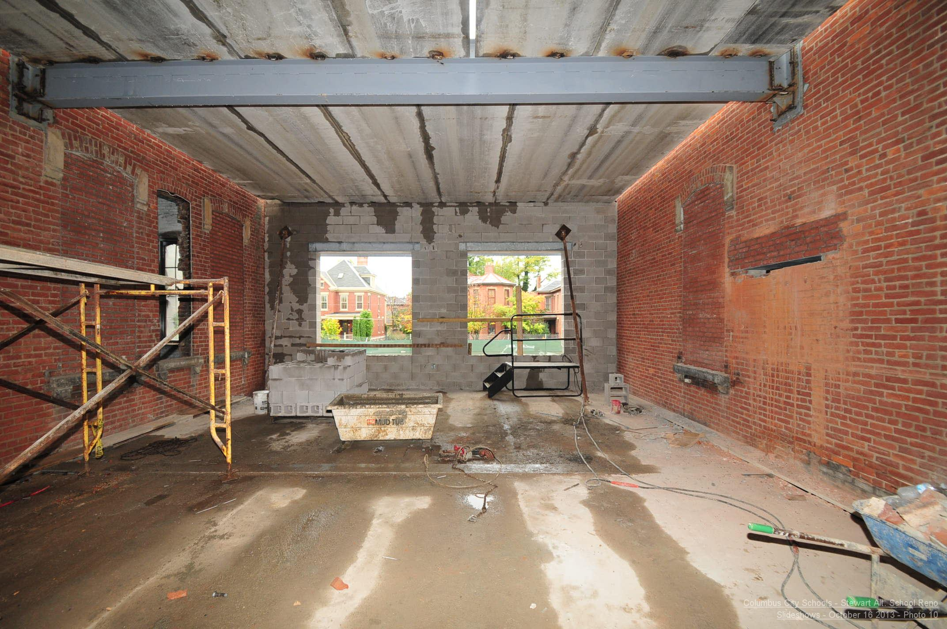
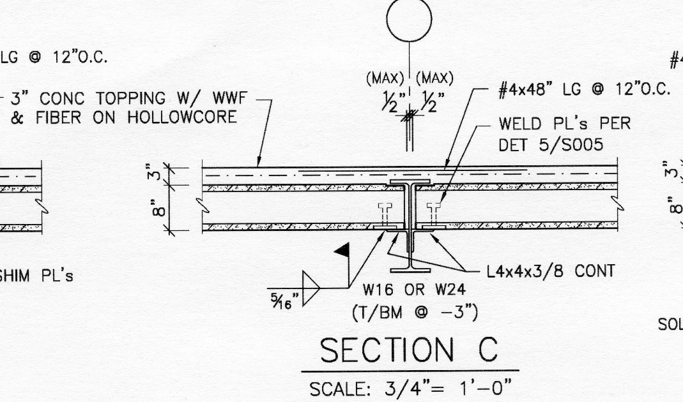
Introduction
Project Background
Analysis 1: 3rd Party Photo Documentation
Analysis 2: Cast-in-Place Concrete Floors
Analysis 3: PEX Domestic Water System
Conclusion
Original Design:
8” precast hollow core concrete planks
Steel W-shape beams anchored to existing masonry walls
3” concrete top coating
Welded wire mesh reinforcement

Slide 26
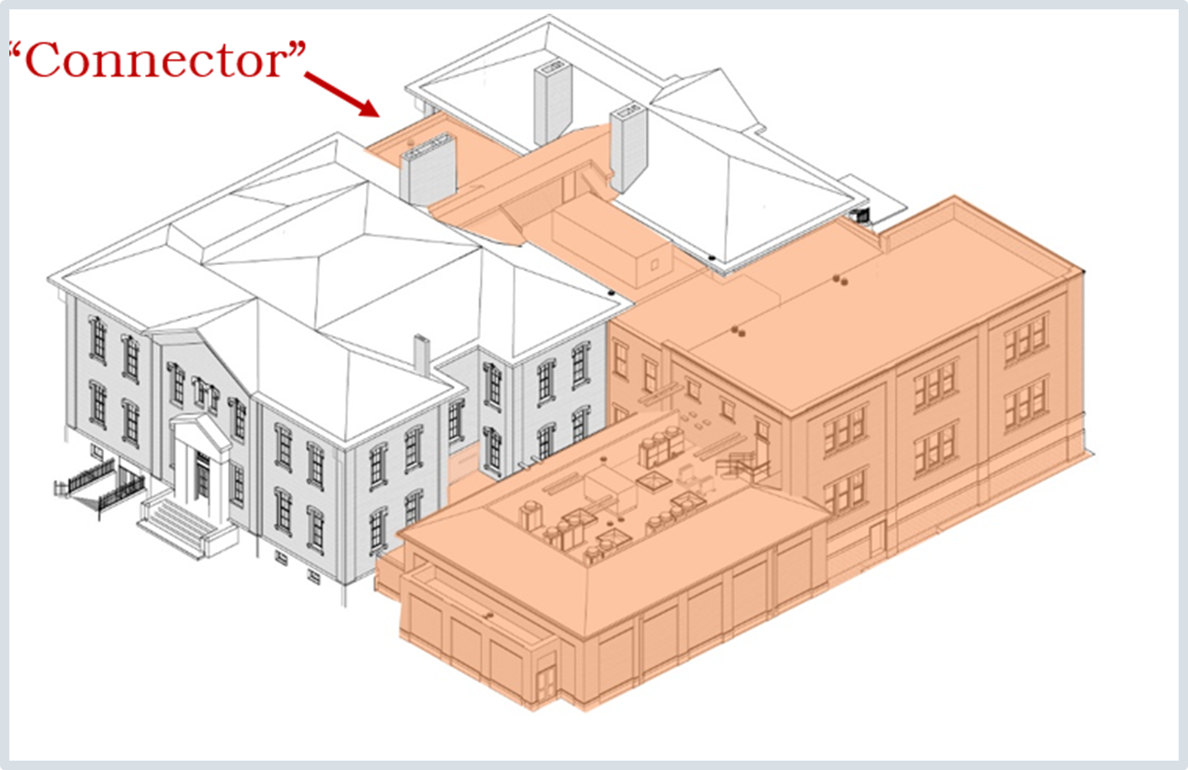
Introduction
Project Background
Analysis 1: 3rd Party Photo Documentation
Analysis 2: Cast-in-Place Concrete Floors
Analysis 3: PEX Domestic Water System
Conclusion
Problem Identification:
Precast concrete planks require accurate dimensions
Measurements for “Connector” section proved difficult
Potential need to move anchor points for steel beams
Limited access to area
Changes require re-order of planks
Limited flexibility for other trades

Slide 27
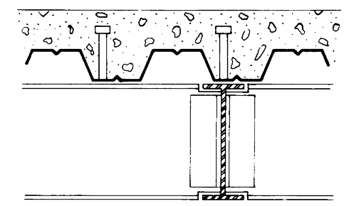
Introduction
Project Background
Analysis 1: 3rd Party Photo Documentation
Analysis 2: Cast-in-Place Concrete Floors
Analysis 3: PEX Domestic Water System
Conclusion
Alternate Design:
Composite steel deck
Cast-in-place concrete
  3½” total thickness
  2” thickness above steel deck
Welded wire mesh reinforcement
Steel W-shape girders anchored to masonry walls
Steel W-shape joists

Slide 28
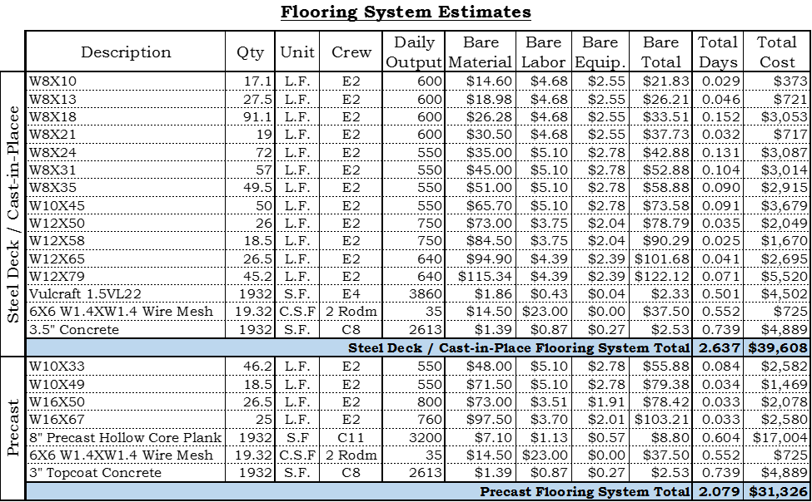
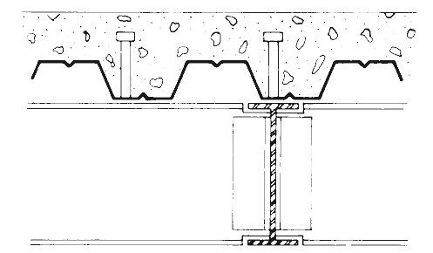
Introduction
Project Background
Analysis 1: 3rd Party Photo Documentation
Analysis 2: Cast-in-Place Concrete Floors
Analysis 3: PEX Domestic Water System
Conclusion
System Comparison:
Labor: 1 additional day
Cost: additional $16,564

Slide 29
Introduction
Project Background
Analysis 1: 3rd Party Photo Documentation
Analysis 2: Cast-in-Place Concrete Floors
Analysis 3: PEX Domestic Water System
Conclusion
Advantages:
No accessibility issues
Onsite adjustability
  Inaccurate measurements
  Compromised anchor points
  Last minute changes
Can conform to MEP requirements
No lead time
System Comparison:
Labor: 1 additional day
Cost: additional $16,564

Slide 30
Introduction
Project Background
Analysis 1: 3rd Party Photo Documentation
Analysis 2: Cast-in-Place Concrete Floors
Analysis 3: PEX Domestic Water System
Conclusion
Structural Breadth:
Design of Steel Deck/Cast-in-Place Flooring System

Slide 31
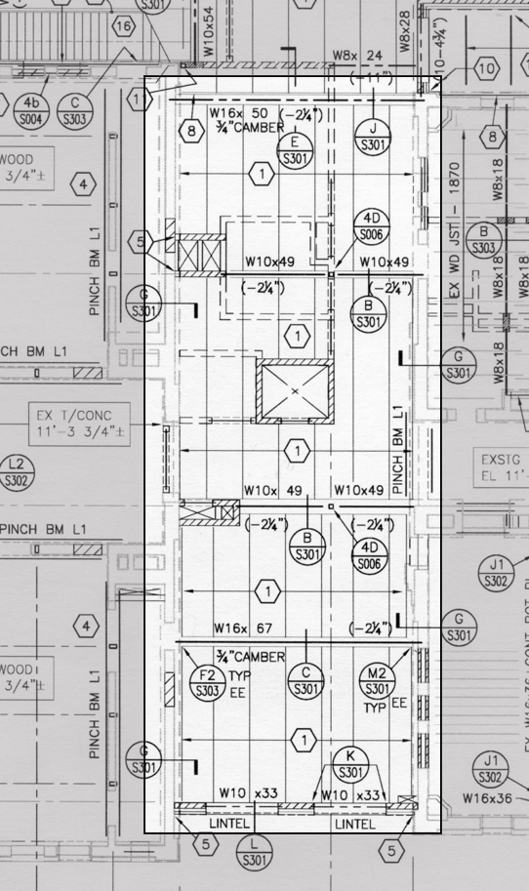
Introduction
Project Background
Analysis 1: 3rd Party Photo Documentation
Analysis 2: Cast-in-Place Concrete Floors
Analysis 3: PEX Domestic Water System
Conclusion
Design Procedure:
Identify the joist spacing
Choose the steel deck and concrete thickness
Calculate the dead and live loads
Calculate the shear, moment and moment of inertia
Choose the beams

Slide 32
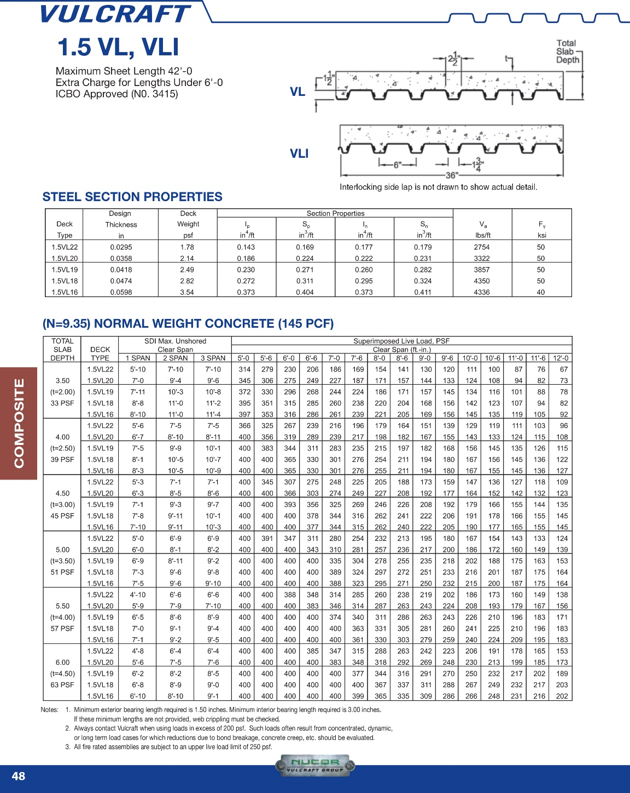
Introduction
Project Background
Analysis 1: 3rd Party Photo Documentation
Analysis 2: Cast-in-Place Concrete Floors
Analysis 3: PEX Domestic Water System
Conclusion
Design Procedure:
Identify the joist spacing
Choose the steel deck and concrete thickness
Calculate the dead and live loads
Calculate the shear, moment and moment of inertia
Choose the beams

Slide 33
Introduction
Project Background
Analysis 1: 3rd Party Photo Documentation
Analysis 2: Cast-in-Place Concrete Floors
Analysis 3: PEX Domestic Water System
Conclusion
Design Procedure:
Identify the joist spacing
Choose the steel deck and concrete thickness
Calculate the dead and live loads
Calculate the shear, moment and moment of inertia
Choose the beams

Slide 34
Introduction
Project Background
Analysis 1: 3rd Party Photo Documentation
Analysis 2: Cast-in-Place Concrete Floors
Analysis 3: PEX Domestic Water System
Conclusion
Design Procedure:
Identify the joist spacing
Choose the steel deck and concrete thickness
Calculate the dead and live loads
Calculate the shear, moment and moment of inertia
Choose the beams

Slide 35
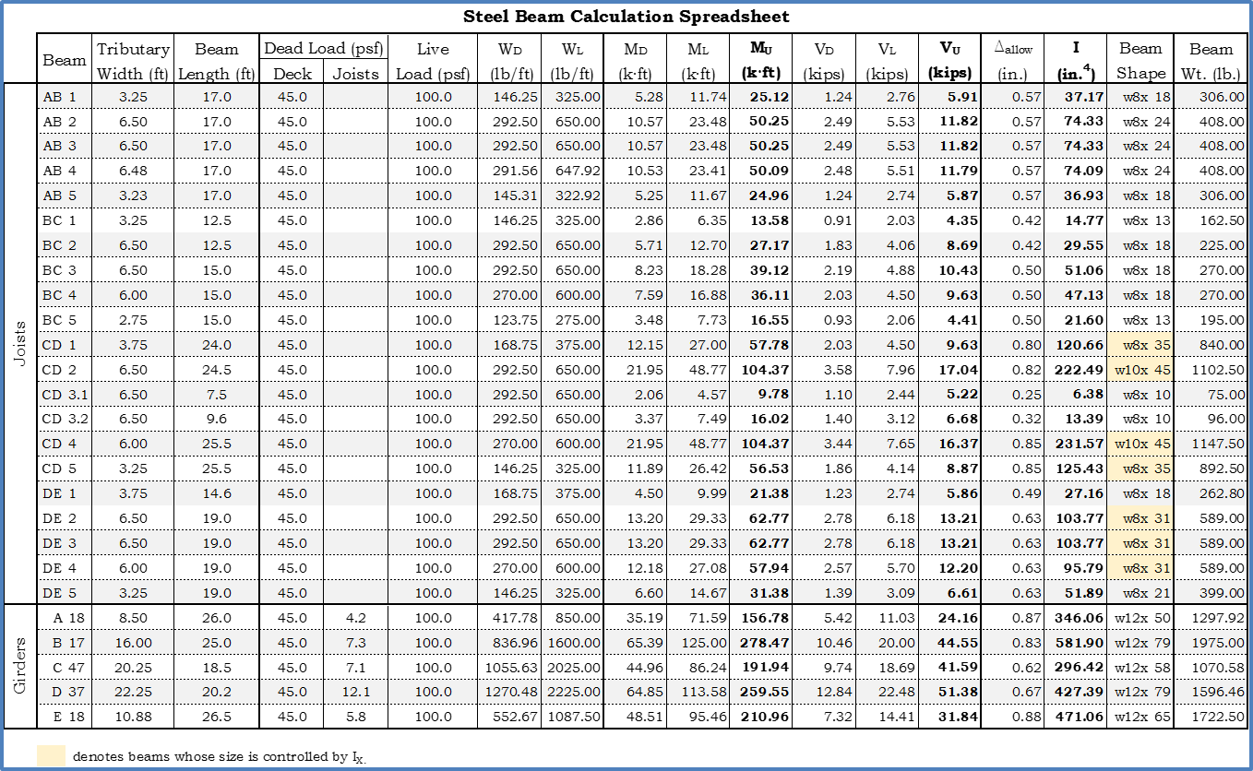
Introduction
Project Background
Analysis 1: 3rd Party Photo Documentation
Analysis 2: Cast-in-Place Concrete Floors
Analysis 3: PEX Domestic Water System
Conclusion
Design Procedure:
Identify the joist spacing
Choose the steel deck and concrete thickness
Calculate the dead and live loads
Calculate the shear, moment and moment of inertia
Choose the beams

Slide 36
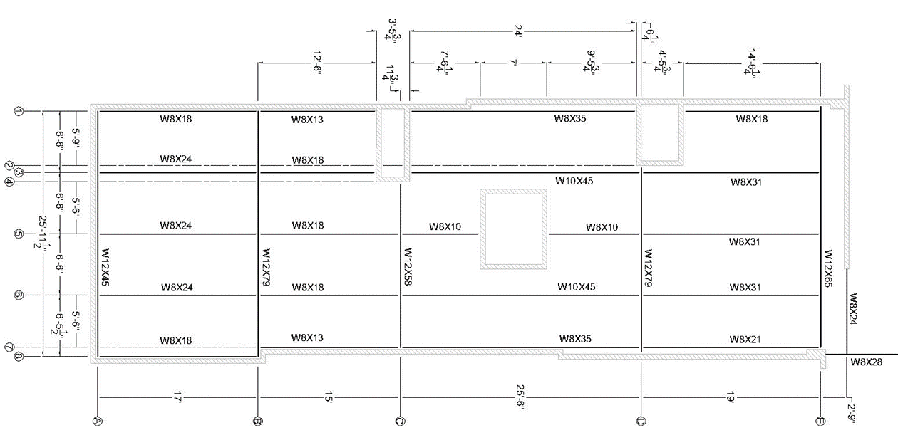
Introduction
Project Background
Analysis 1: 3rd Party Photo Documentation
Analysis 2: Cast-in-Place Concrete Floors
Analysis 3: PEX Domestic Water System
Conclusion
Design Procedure:
Identify the joist spacing
Choose the steel deck and concrete thickness
Calculate the dead and live loads
Calculate the shear, moment and moment of inertia
Choose the beams

Slide 37
Introduction
Project Background
Analysis 1: 3rd Party Photo Documentation
Analysis 2: Cast-in-Place Concrete Floors
Analysis 3: PEX Domestic Water System
Conclusion
Analysis #3:
Use of PEX Tubing for Domestic Plumbing System

Slide 38
Introduction
Project Background
Analysis 1: 3rd Party Photo Documentation
Analysis 2: Cast-in-Place Concrete Floors
Analysis 3: PEX Domestic Water System
Conclusion
Problem Identification:
Copper is expensive
Soldering joints is labor intensive
High risk of theft
Original Design:
Copper pipe – sizes 3” to ½”
Soldered joints
Cold, hot and hot water return lines
Trunk and branch layout
Alternate Design:
Cross-linked polyethylene tubing (PEX) – 2” to ½”
    (larger pipes to remain copper)
Clamped joints
No 90° elbows in ½”, ¾” or 1” pipe
Cold, hot and hot water return lines
Trunk and branch layout

Slide 39
Introduction
Project Background
Analysis 1: 3rd Party Photo Documentation
Analysis 2: Cast-in-Place Concrete Floors
Analysis 3: PEX Domestic Water System
Conclusion
Advantages:
Less Expensive (50%)
Faster Install (67%)
No Open Flames
Fewer Fittings
No “dry fit” joints
Corrosion resistant
Disadvantages:
Special equipment
Learning curve
Unknown longevity
Not bacteriostatic
Not UV resistant
Not fireproof

Slide 40
Introduction
Project Background
Analysis 1: 3rd Party Photo Documentation
Analysis 2: Cast-in-Place Concrete Floors
Analysis 3: PEX Domestic Water System
Conclusion
Plumbing Breadth:
Compare Friction Loss in PEX System to that in Copper System

Slide 41
Introduction
Project Background
Analysis 1: 3rd Party Photo Documentation
Analysis 2: Cast-in-Place Concrete Floors
Analysis 3: PEX Domestic Water System
Conclusion
Procedure:
Determine design velocity – 4ft/s
Calculate flow
Calculate friction loss
Calculate total equivalent length
Calculate total friction loss

Slide 42
Introduction
Project Background
Analysis 1: 3rd Party Photo Documentation
Analysis 2: Cast-in-Place Concrete Floors
Analysis 3: PEX Domestic Water System
Conclusion
Procedure:
Determine design velocity – 4ft/s
Calculate flow
Calculate friction loss
Calculate total equivalent length
Calculate total friction loss

Slide 43
Introduction
Project Background
Analysis 1: 3rd Party Photo Documentation
Analysis 2: Cast-in-Place Concrete Floors
Analysis 3: PEX Domestic Water System
Conclusion
Procedure:
Determine design velocity – 4ft/s
Calculate flow
Calculate friction loss
Calculate total equivalent length
Calculate total friction loss

Slide 44
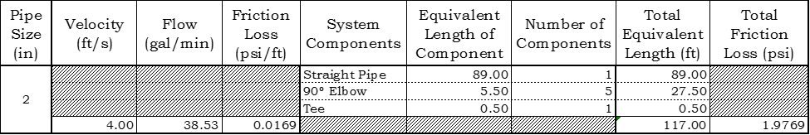
Introduction
Project Background
Analysis 1: 3rd Party Photo Documentation
Analysis 2: Cast-in-Place Concrete Floors
Analysis 3: PEX Domestic Water System
Conclusion
Procedure:
Determine design velocity – 4ft/s
Calculate flow
Calculate friction loss
Calculate total equivalent length
Calculate total friction loss

Slide 45
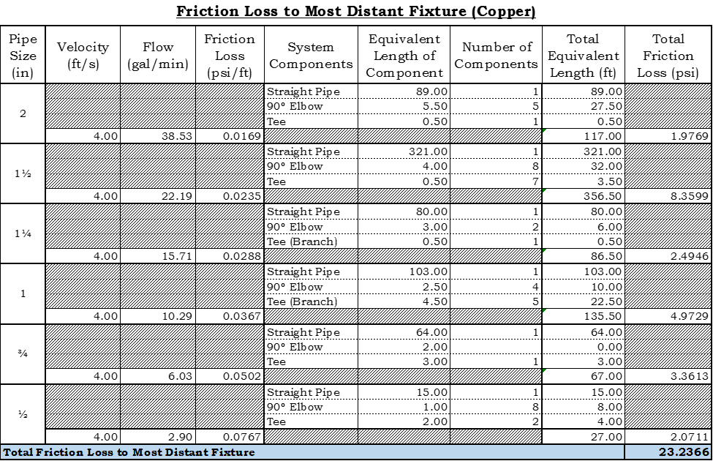
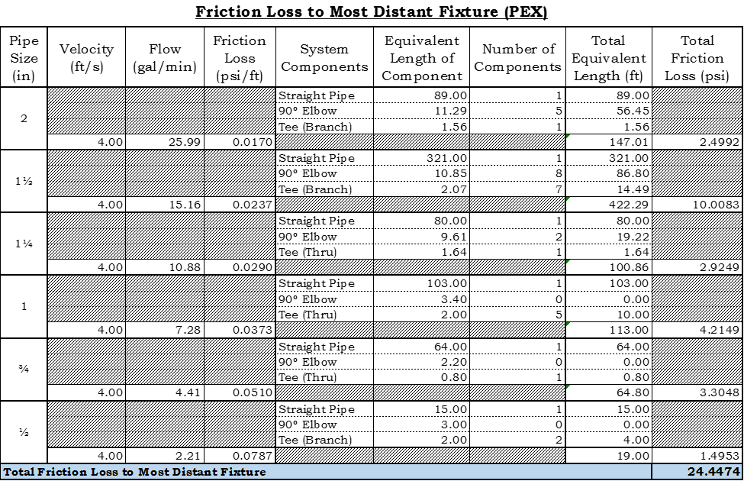
Introduction
Project Background
Analysis 1: 3rd Party Photo Documentation
Analysis 2: Cast-in-Place Concrete Floors
Analysis 3: PEX Domestic Water System
Conclusion
Procedure:
Determine design velocity – 4ft/s
Calculate flow
Calculate friction loss
Calculate total equivalent length
Calculate total friction loss
24.45 psi
-23.24 psi
1.21 psi

Slide 46
Introduction
Project Background
Analysis 1: 3rd Party Photo Documentation
Analysis 2: Cast-in-Place Concrete Floors
Analysis 3: PEX Domestic Water System
Conclusion
Conclusion

Slide 47
Introduction
Project Background
Analysis 1: 3rd Party Photo Documentation
Analysis 2: Cast-in-Place Concrete Floors
Analysis 3: PEX Domestic Water System
Conclusion
Analysis #1: 3rd-Party Photo Documentation
$0.20 - $0.60 / sqft
Reliable
Organized and accessible photos
Reduces litigation
Increases productivity
“Green”

Slide 48
Introduction
Project Background
Analysis 1: 3rd Party Photo Documentation
Analysis 2: Cast-in-Place Concrete Floors
Analysis 3: PEX Domestic Water System
Conclusion
Analysis #1: 3rd-Party Photo Documentation
$0.20 - $0.60 / sqft
Reliable
Organized and accessible photos
Reduces litigation
Increases productivity
“Green”
Analysis #2: Cast-in-Place Concrete Floors
No accessibility issues
Flexibility during installation
Easy coordination of penetrations
No lead time

Slide 49
Introduction
Project Background
Analysis 1: 3rd Party Photo Documentation
Analysis 2: Cast-in-Place Concrete Floors
Analysis 3: PEX Domestic Water System
Conclusion
Analysis #1: 3rd-Party Photo Documentation
$0.20 - $0.60 / sqft
Reliable
Organized and accessible photos
Reduces litigation
Increases productivity
“Green”
Analysis #2: Cast-in-Place Concrete Floors
No accessibility issues
Flexibility during installation
Easy coordination of penetrations
No lead time
Analysis #3: PEX Domestic Water System
50% savings in material cost
67% savings in installation time
Fewer fittings = fewer leaks
No corrosion
Low risk of theft

Slide 50
Introduction
Project Background
Analysis 1: 3rd Party Photo Documentation
Analysis 2: Cast-in-Place Concrete Floors
Analysis 3: PEX Domestic Water System
Conclusion
Academic Acknowledgements:
Robert Leicht
Kevin Parfitt
Moses Ling
Stephen Treado
Industry Acknowledgements:
Peggy Murphy - SERS
Matt Allen - SERS
Joe Studer - SERS
Randy Johnson - Multivista
Matt Rolfe - Multivista
Gary Runyan - Zurn
Dalton Deeter – Deeter Plumbing & Heating
Shashi Savla – Kabil Associates
Raymond Roy - Uponor
Matthew Barrett – W.G. Tomko
Gregory Costa - McKamish
Questions?

